Slide 1
Supply Chain Assignment 2
Anshuman Dash

Slide 2
Assumptions & Deliverables
Assumptions
Grocery Store is open From Sunday to Friday. Store is closed on Saturday.
Planning and Ordering happens on Saturdays for the next week. Placed with one DC agent only
Delivery happens by Sunday morning of all products by the DC agent
There are no timings here considering the product can be bought at any time of the day
There are no seasonal or peak effects.
There could be leftovers of the week, but intent is not to loose revenue due to ‘Stock Outs’
Deliverables
Predict what quantity is needed for the Week 11 for each product
Unearth any correlations using WK10 POS info
Did these correlations influence predicting other products?

Slide 3
Categorization of products based on quantity consumed(FMS)
Product | Quantity | % Consumed | Cumulative Quantity | Product Category
Eggs | 1413 | 15% | 15% | F
Rice | 845 | 9% | 24% | F
Bread | 744 | 8% | 32% | F
Flour | 719 | 8% | 39% | F
Milk | 686 | 7% | 47% | F
Dal | 546 | 6% | 52% | F
Chips | 506 | 5% | 58% | F
Biscuits | 488 | 5% | 63% | F
Drinks | 427 | 5% | 67% | F
Cooking Oil | 388 | 4% | 71% | F
Chocolates | 358 | 4% | 75% | F
Toothbrush | 339 | 4% | 79% | F
Dish Soap | 337 | 4% | 82% | M
Masalas | 336 | 4% | 86% | M
Soap | 250 | 3% | 88% | M
Cereals | 241 | 3% | 91% | M
Ketchup | 218 | 2% | 93% | M
Clothes Soap | 178 | 2% | 95% | M
Cheese | 175 | 2% | 97% | S
Toothpaste | 157 | 2% | 99% | S
Jam | 126 | 1% | 100% | S
Based on the weekly sale of products quantity for last
10 weeks, classification of the products as:
Top 80% by quantity sold (Fast Moving)
80%-95% by quantity sold (Medium Moving)
Bottom 5% by quantity sold (Slow Moving / No Moving)
FMS Categorization Summary
Product Category | # of Products | % Of Products
Fast Moving(F) | 7459 | 79%
Medium Moving(M) | 1560 | 16%
Slow Moving(S) | 458 | 5%

Slide 4
Predict Quantity Needed for WK11
Product | Forecasted Quantity for WK11
Eggs | 147
Milk | 65
Bread | 73
Rice | 82
Buiscuit | 56
Chocolate | 32
Dal | 53
Flour | 73
Soap | 30
Toothbrush | 28
Toothpaste | 18
Cereals | 23
Chips | 51
Drinks | 49
Cooking Oil | 43
Cheese | 25
Jam | 18
Ketchup | 19
Dish Soap | 33
Clothes Soap | 17
Masalas | 33
Product Demand Forecast –
Capture demand of the items based on actual sale during previous weeks
Demand forecast based on de-seasonalized demand
Usage of 4 period simple moving average for calculation of demand forecast in WK11
Observation
Several high quantity items are purchased by females aged between 35-50 on Sundays, Mondays and Fridays

Slide 5
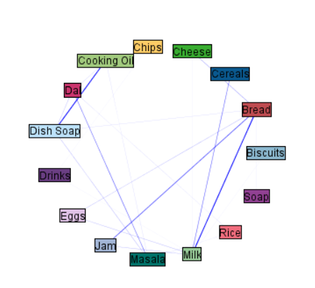
WK10 Product Sales association Analysis
Products sold during WK10 was analyzed for any association
Data was analyzed using SPSS modeller
It is observed that there is strong association between Milk, Bread and Jam
There is strong association between Cooking Oil and Dish Soap
There is some amount of association between Milk & Cereals and between Masala & Dal

Slide 6
WK10 Product Sales association Analysis
Top 30 associations based on Lift values
Lift values greater than 1 is considered good association

Slide 7
Thank You

